Slide 1
GNSH 30 Minute Weekly Initiative
(in collaboration with Patient Safety Organizations)

Slide 2
GNSH 30 Minute Weekly Initiative
(in collaboration with Patient Safety Organizations)
Patient’s
Story Part 1
Team
Engagement
Patient’s
Story Part 2
Team
Discussion
Systems
Discussion
30 min
Weekly
what we are trying to do with the team
build link
to patient
(emotional)
reflection on coordination of care by team
outcome and its impact
(emotional)
reflection on case to improve future care
reflection
on system
challenges
each week’s story coordinated across participating institutions
to encourage further discussions among peers …
each Trauma team
each ED team
each ICU team
each OR team
each LDR team
each Sanitation team
each Legal team
each Admissions team
each Lab team
each Radiology team
…
…
…
each XXX team
each hospital in USA
each hospital in Canada
each hospital in UK
each hospital in Australia
each hospital in China
each hospital in India
…
…
…
each hospital in XXX
Week 4 – Care Teams
Week 1 - Sepsis
Week 2 – Medication Error
Week 3 – HAI
0
target number of healthcare professionals to train weekly
59 million
X million
number of patients harmed from preventable medical errors
0

Slide 3

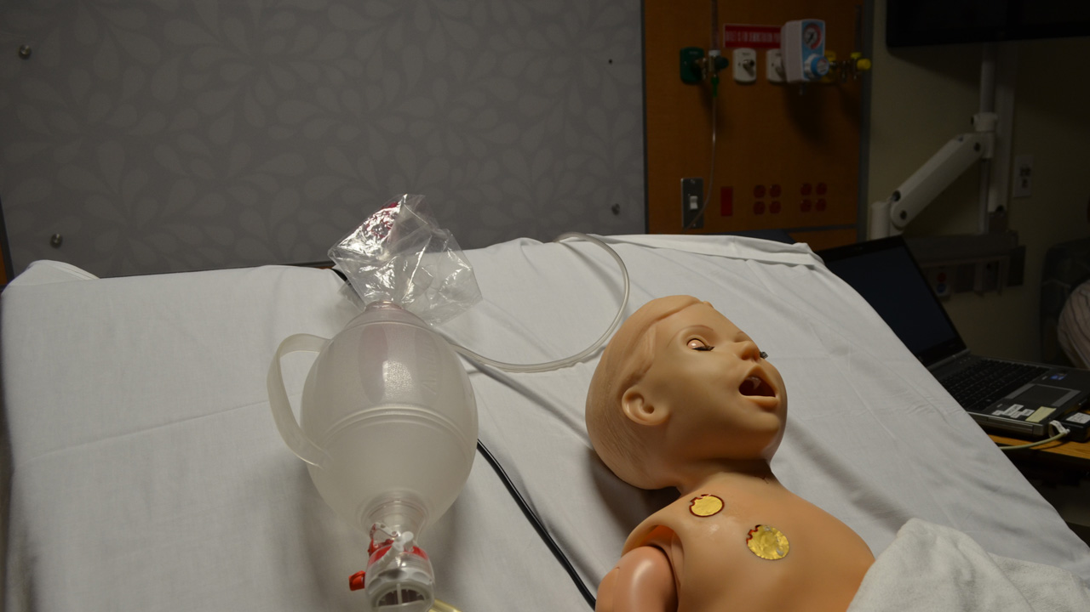
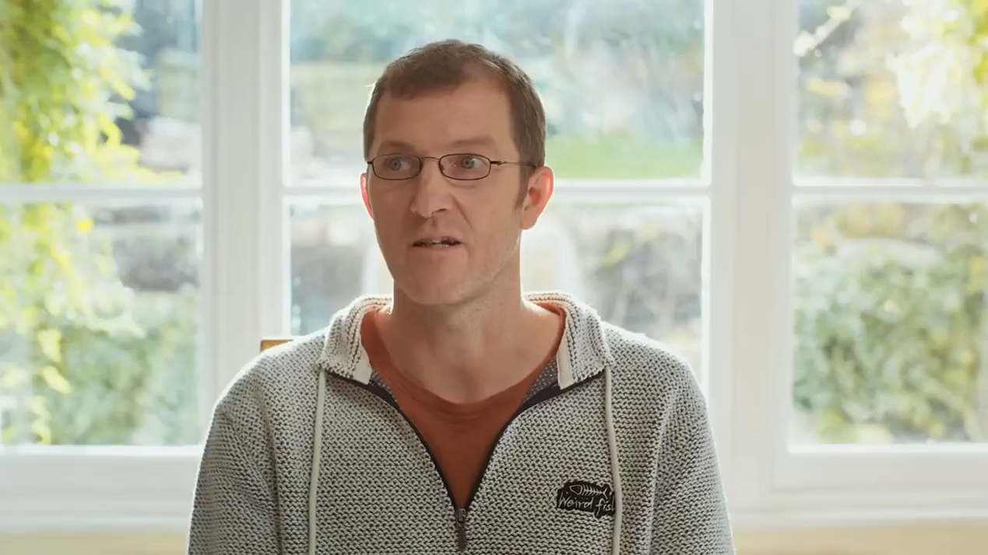
30 Minute Weekly Framework …
Patient’s
Story Part 1
Team Engagement
Patient’s
Story Part 2
Patient’s
Story Part 1
Team Engagement
Patient’s
Story Part 2
Team
Discussion
Systems
Discussion
30 min
Weekly
what we are trying to do with the team
build link
to patient
(emotional)
reflection on coordination of care by team
outcome and its impact
(emotional)
reflection on case to improve future care
reflection
on system
challenges

Slide 4

Introduction to the Patient (< 2 min)

Slide 5
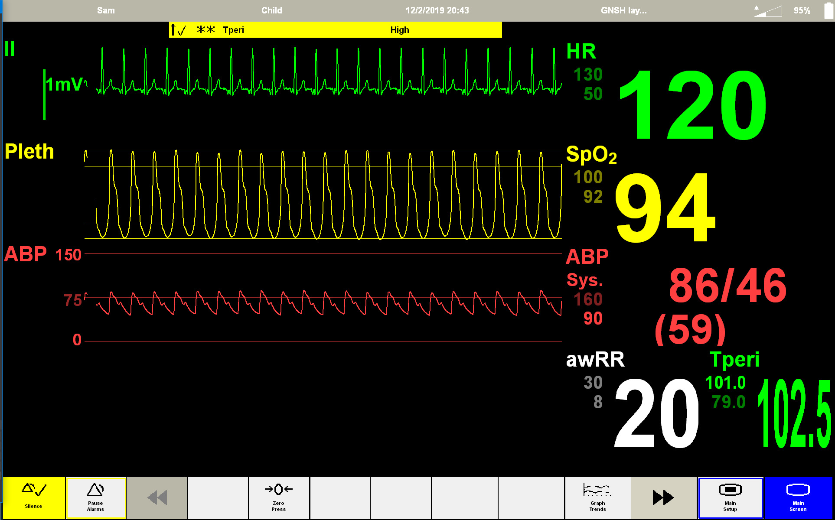

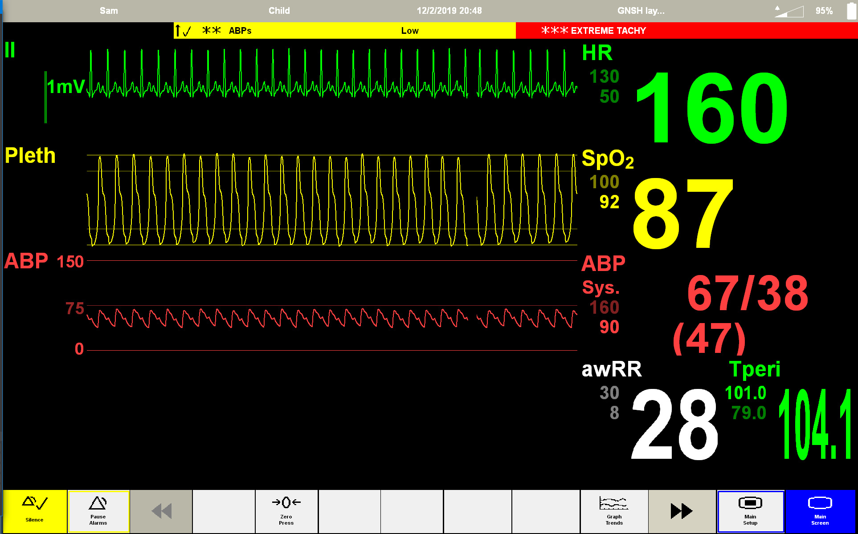
Team Engagement: Critical Decision Points

Slide 6
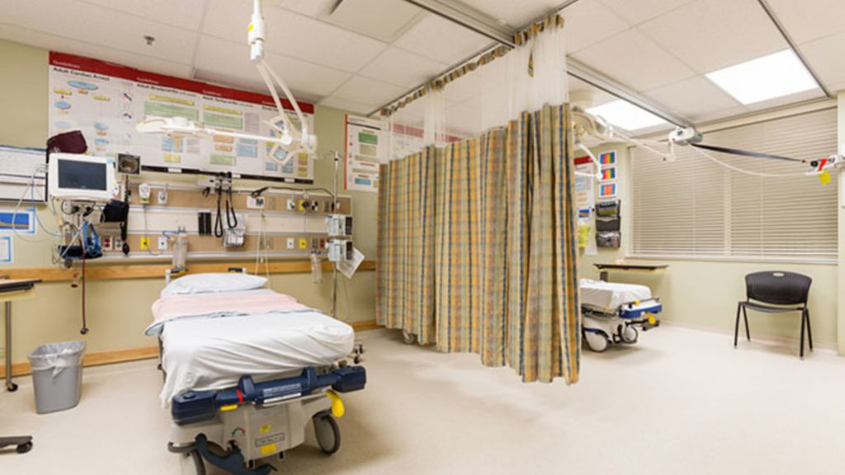
Assessment (~3 min)
What do you think is going on with this patient?
(everyone to answer)
Share what you are most concerned about.
(everyone to answer)

Slide 7

Patient’s Story - Outcomes (< 3 min)

Slide 8
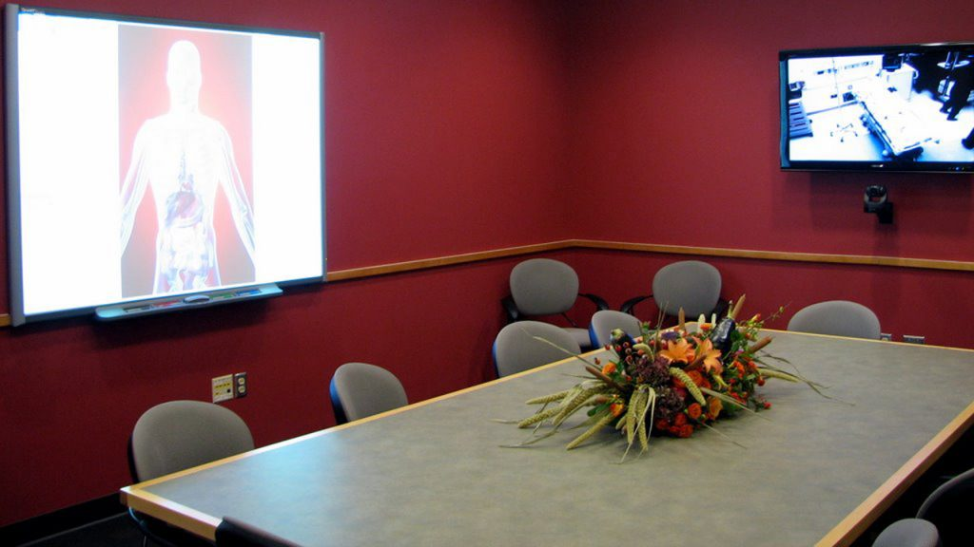
Team Discussion (~5 min)
What can our team learn from this case to improve the care in a similar situation?

Slide 9
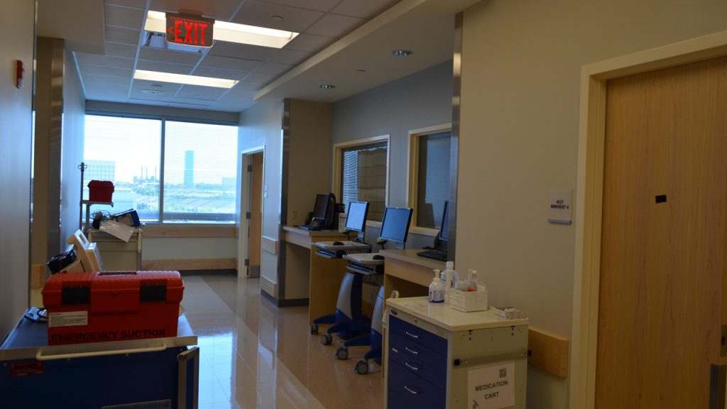
Systems Discussion (~5 min)
What system issues might have contributed to this outcome?
(every team member to answer)
What systems do we have in place to prevent this?
(every team member to answer)

Slide 10
GNSH 30 Minute Weekly Initiative
(in collaboration with Patient Safety Organizations)
Patient’s
Story Part 1
Team
Engagement
Patient’s
Story Part 2
Team
Discussion
Systems
Discussion
30 min
Weekly
what we are trying to do with the team
build link
to patient
(emotional)
reflection on coordination of care by team
outcome and its impact
(emotional)
reflection on case to improve future care
reflection
on system
challenges
each week’s story coordinated across participating institutions
to encourage further discussions among peers …
each Trauma team
each ED team
each ICU team
each OR team
each LDR team
each Sanitation team
each Legal team
each Admissions team
each Lab team
each Radiology team
…
…
…
each XXX team
each hospital in USA
each hospital in Canada
each hospital in UK
each hospital in Australia
each hospital in China
each hospital in India
…
…
…
each hospital in XXX
Week 4 – Care Teams
Week 1 - Sepsis
Week 2 – Medication Error
Week 3 – HAI
0
target number of healthcare professionals to train weekly
59 million
X million
number of patients harmed from preventable medical errors
0

