Slide 1
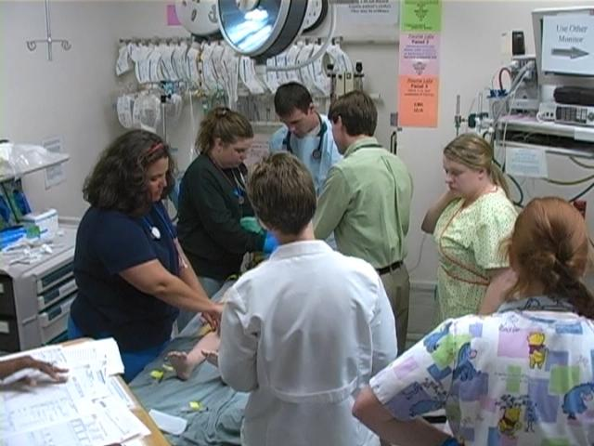
Simulation: A Strategy to Improve Patient Safety and Quality
Mary Patterson MD, MEd

Slide 2
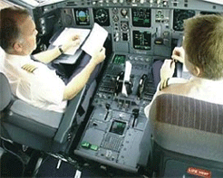
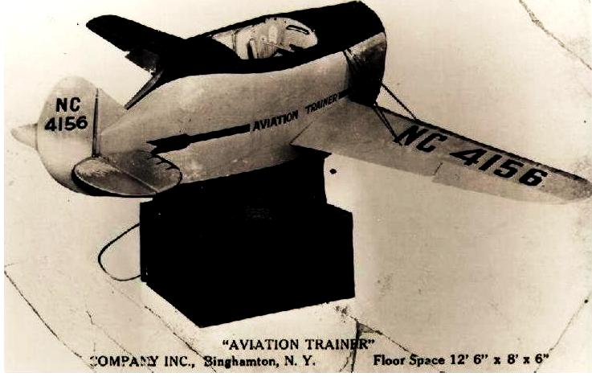
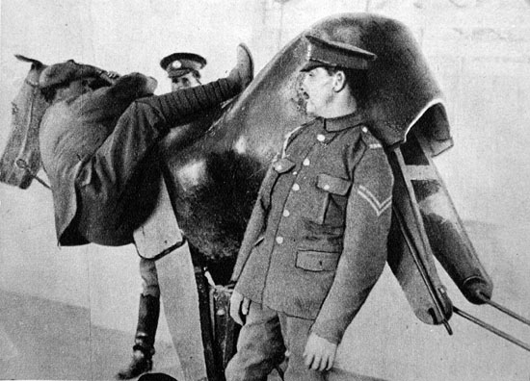
Simulation in Practice
Most industries that have the risk of losing lives or valuable assets have adopted simulation as part of their basic operations
  Military: training simulations
  Airlines: flight simulators
  Financial Planning: computer simulations
  Nuclear Power: reactor simulators
Notes:
2
Aviation invests 10% of its operating budget in simulation- The copilot on a plane may be flying that particular plane in reality for the first time.
Nuclear power plants invest 15 % of their operating budgets in simulation
And in fact spend one week in 6 in a simulator.
Link Trainer –the first aviation simulator. US Postal service commissioned 6 of these in the late 1920’s

Slide 3
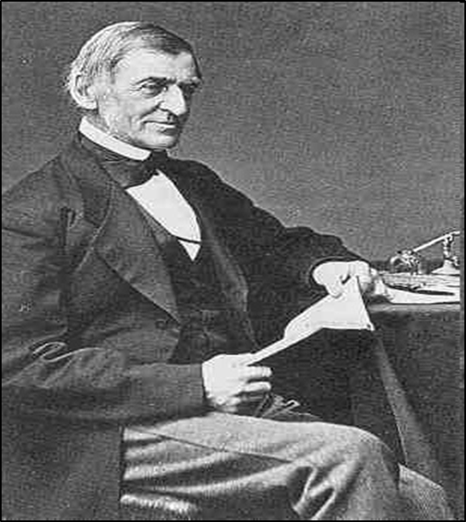
Why Simulation?
Competence
Reliability
Resilience
Scripting unexpected events
Ethical Imperative
No longer acceptable to “learn” on patients
Skill to do comes of doing -Ralph Waldo Emerson

Slide 4
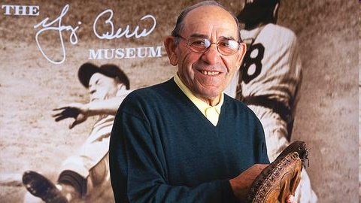
Types of Competencies
Technical
  Individual
  Team
Non-technical:
Communication and Teamwork (CRM)
  Individual
  Team
System
  “In theory there's no difference between theory and practice. In practice there is."
  -Yogi Berra

Slide 5
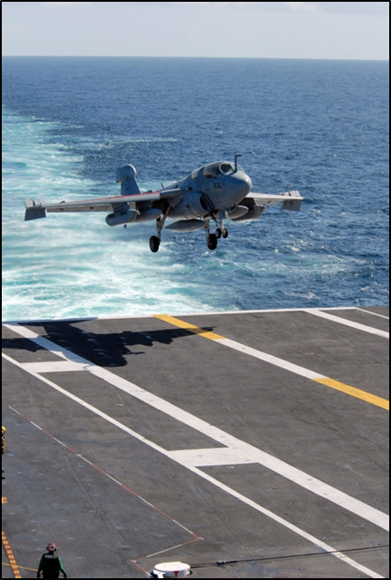
How do other high risk industries achieve high reliability?
Deliberate Practice
Technical
Non-Technical Skills
Communication and Teamwork Training (CRM)
System Design
Human Factors

Slide 6
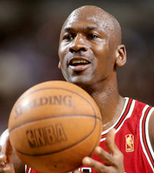
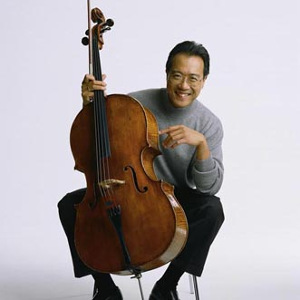
Deliberate Practice
Deliberate practice involves two kinds of learning:
  improving the skills you already have
  extending the reach and range of your skills
Deliberate practice entails specific, and sustained efforts to do something you can’t do well—or even at all
Research across domains: it is only by working at what you can’t do that you become expert
The 10,000 hour rule- Anders Ericsson
Notes:
Bill Gates – 8th grade –sophomore year of college -7 years programming almost continuously – Univ of Washington. Seattle Stealing time from the Univ of Washington between 3 and 6.am.

Slide 7
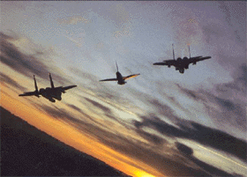
Non-Technical Skills:
CRM is designed to train team members how to achieve maximum mission effectiveness in a time-constrained environment under stress
      -Kern, 2001
Notes:
Provides a systematic way of defining:
Roles
Responsibilities
Algorithms for responding to critical situations
Methods of communication

Slide 8
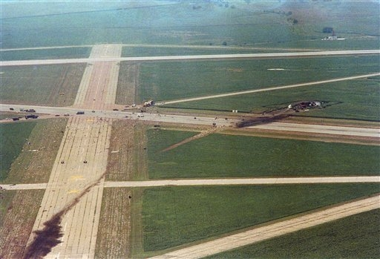
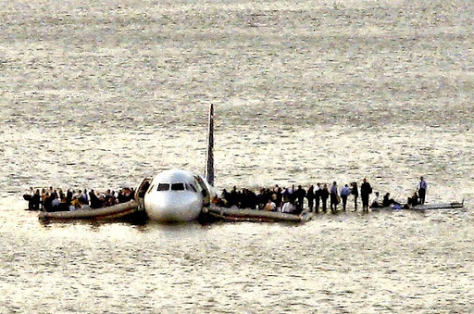
United Flight 232
Until 1980, the captain was THE authority on the aircraft. What he said, goes. And we lost a few airplanes because of that.
Sometimes the captain wasn’t as smart as we thought he was. And we would listen to him, and do what he said, and we wouldn't know what he's talking about.
We had 103 years of flying experience there in the cockpit, trying to get that airplane on the ground, not one minute of which we had actually practiced, any one of us. So why would I know more about getting that airplane on the ground under those conditions than the other three.
If I hadn't used [CRM], if we had not let everybody put their input in, it's a cinch we wouldn't have made it
    -Capt Al Haynes
.[

Slide 9
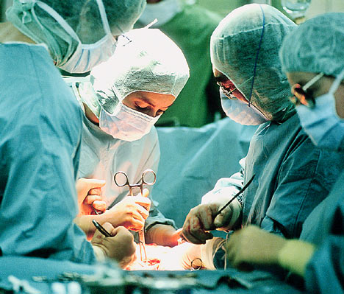
What about Healthcare?
Daily work is not deliberate practice
Can’t take same risks that occur with deliberate practice.
Feedback is frequently missing

Slide 10
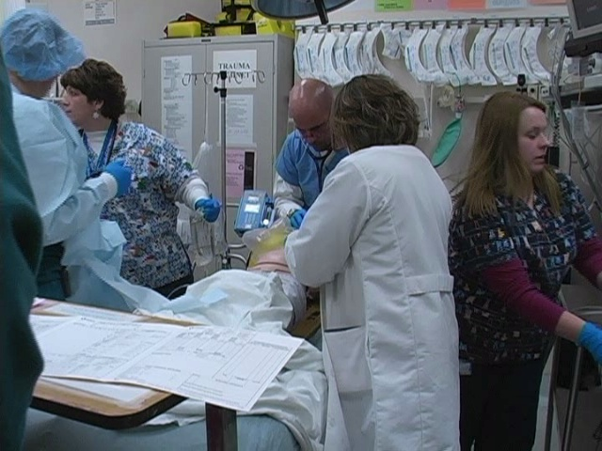
Our patients are more complex and more ill than in years past
Healthcare providers have less experience
  Work hour restrictions
  New Graduates
Limited time dedicated to hands on training

Slide 11
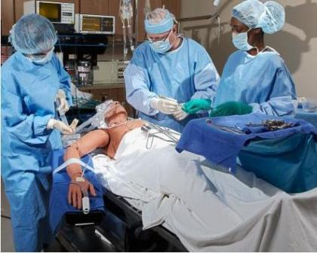
Mastery Learning and Deliberate Practice
The goal of mastery learning is to ensure that all learners accomplish all educational objectives with little or no outcome variation.
Time needed to reach mastery standards for a unit’s
educational objectives varies among learners.
Paradigm shift from the way many other educational activities are currently carried out
  Wayne and McGaghie

Slide 12
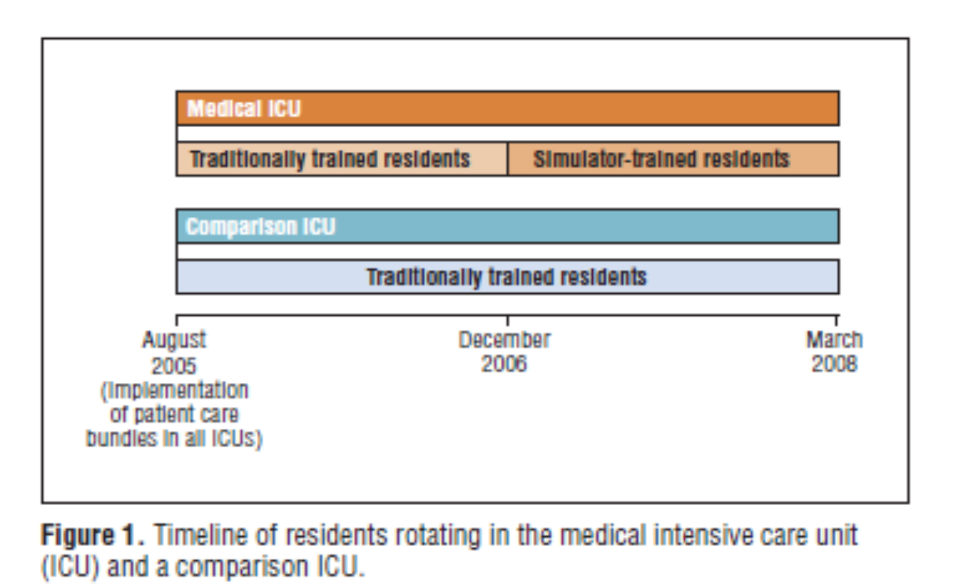

Slide 13

Central Venous Catheter Placement
Both ICU’s started with same rate of CRBSI
After intervention: MICU 0.5 CRBSI/1000 catheter days
SICU at >5 CRBSI/1000 catheter days
$700,000 net savings, and 12.2 days in MICU per infection
  Barsuk, McGaghie, Wayne: Arch Intern Med. 2009;169(15):1420-1423
  Cohen et al:Simul Healthc. 2010 Apr;5(2):98-102

Slide 14
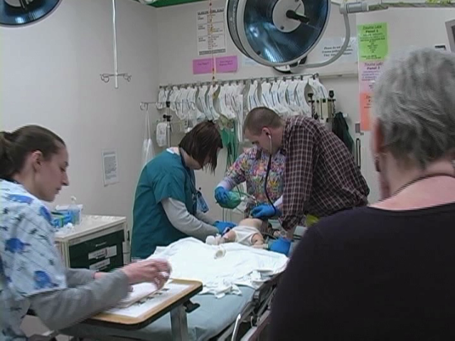
Cincinnati Children’s ED
Baseline SSE rate 2-3 per year
Intervention: Focused and repetitive simulation training
Measure: ED has had one SSE in 3 years
Knowledge + Practice = Behavior and Culture Changes
  Speaking up
  Shared mental models
  Situation awareness

Slide 15
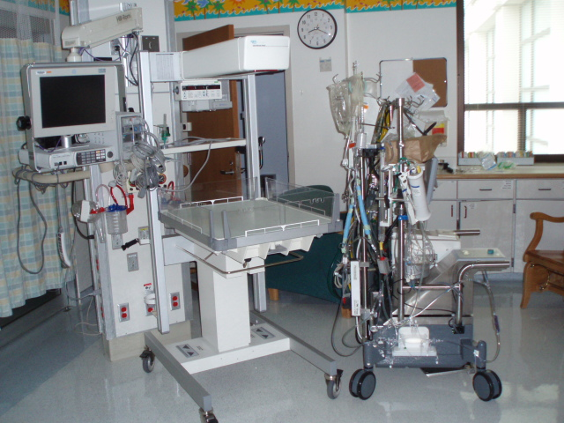
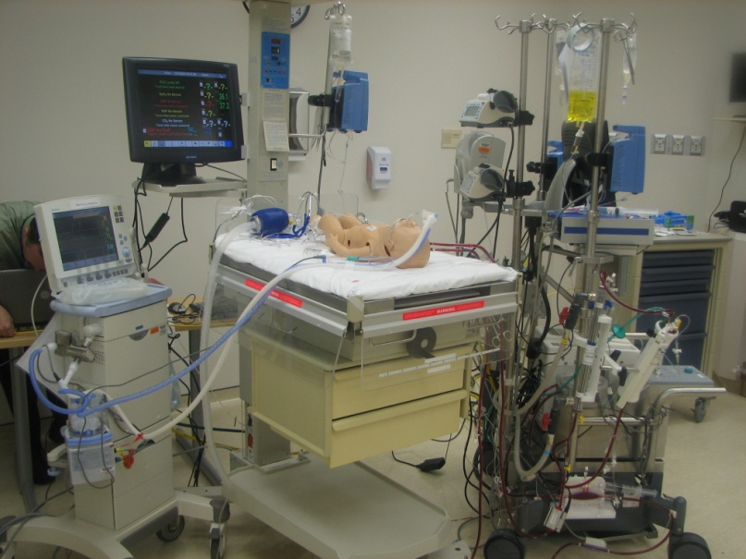
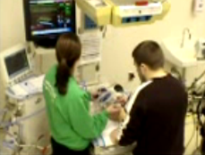
Simulations provide the opportunity for Deliberate Practice of:
Asking clarifying questions, crosschecking,
ARC, STAR, SBAR, QVV
Assertive statements, shared mental models, challenging authority gradients,
High risk/infrequent scenarios
Managing unexpected events

Slide 16
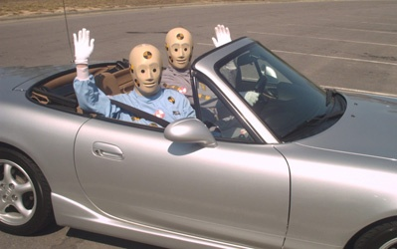
In Situ Simulations :
“Crash testing the dummy”
Identification of latent hazards/systems issues
New and existing environments
  Systems
  Equipment/Resources
  Teams

Slide 17
Simulation Training Provides a High Return on Investment
University of Pittsburgh noted a substantial decrease in claims for airway mishaps after instituting their simulation courses for all personnel who manage airways in their system.
Claims have decreased from approximately two dozen a year to less than ten claims since.
  Michael DeVita, University of Pittsburgh

Slide 18
Simulation Training Provides a High Return on Investment
Harvard noted a 50% decrease in malpractice claims for anesthesiologists that have attended a simulation-based risk reduction course.
  Luke Sato, Harvard Risk Management Foundation
Beth Israel in Boston decreased the number of adverse events in obstetrics by 50% since they instituted a simulation-based risk reduction program.
  Luke Sato, Harvard Risk Management Foundation

Slide 19

Current Status Quo:
Unintended Consequences
Professional silos
Weak teamwork
Poor concept of system
Novices “practice” on patients-no assurance of competency
Inefficiency in practice and design
Little integration of preclinical and clinical work

Slide 20
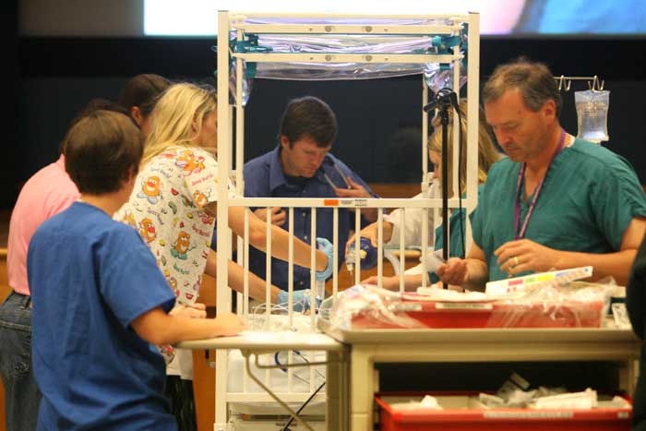
Is there a better way?
Healthcare education should be interdisciplinary
Healthcare education should incorporate simulation in a variety of venues-preclinical and clinical
Healthcare proficiency assessments should be part of training and incorporate simulation to assess competency when appropriate

Slide 21
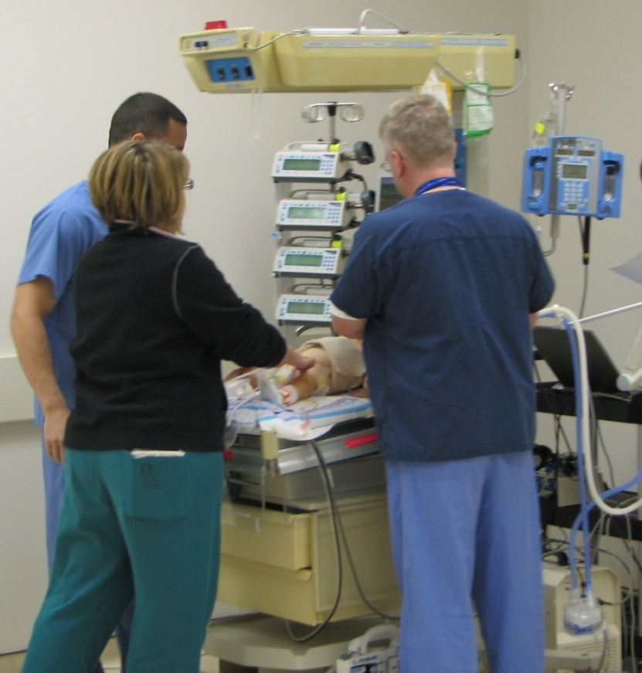
New Frontier
Competence isn’t just about individuals
  Multifaceted
We need better tools to evaluate competence
  Adapt tools from other disciplines
Need to create expectation that competence will be evaluated for systems, for teams and for individuals

Slide 22


Simulation For Safety and Reliability
Vision
The Center will be a local, regional and national center of excellence and innovation for healthcare simulation, education, and research with the fundamental goal of advancing patient safety and reliability

Slide 23
“Individuals tend to normalize deviance and not notice all the “accidents waiting to happen” with repeated exposure over time
The risk is….
Simulation makes these conditions explicitly visible and will lead to frustration and anger that the organization is only committed to patient safety on the backs of hypervigilant individuals, rather than robust supporting systems”
  George Blike

Slide 24

Thank you for your attention Questions?
We are what we repeatedly do.
Excellence, then, is not an act, but a habit.
-Aristotle

